Slide 1

Topic one
Subtitle

Slide 2
Topic one
Subtitle

Slide 3
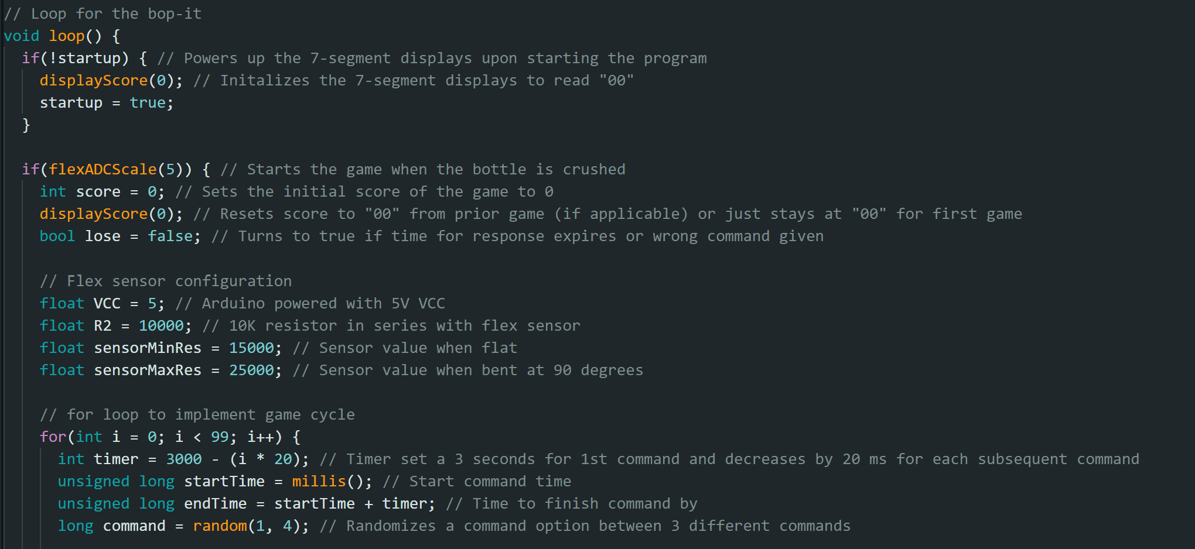
Arduino Code - Jake
Initial loop created
LED w/ sound for commands
Code will need adjusted pending results of when the bottle is bult to scale flex sensor (analog)
Other inputs are digital (hall effect sensor, tilt sensor)

